Slide 1
Presentation title
Jon Herman

Slide 2
DWR estimates daily full natural flows (~unimpaired) for the basins along the Sacramento and San Joaquin rivers

Slide 3
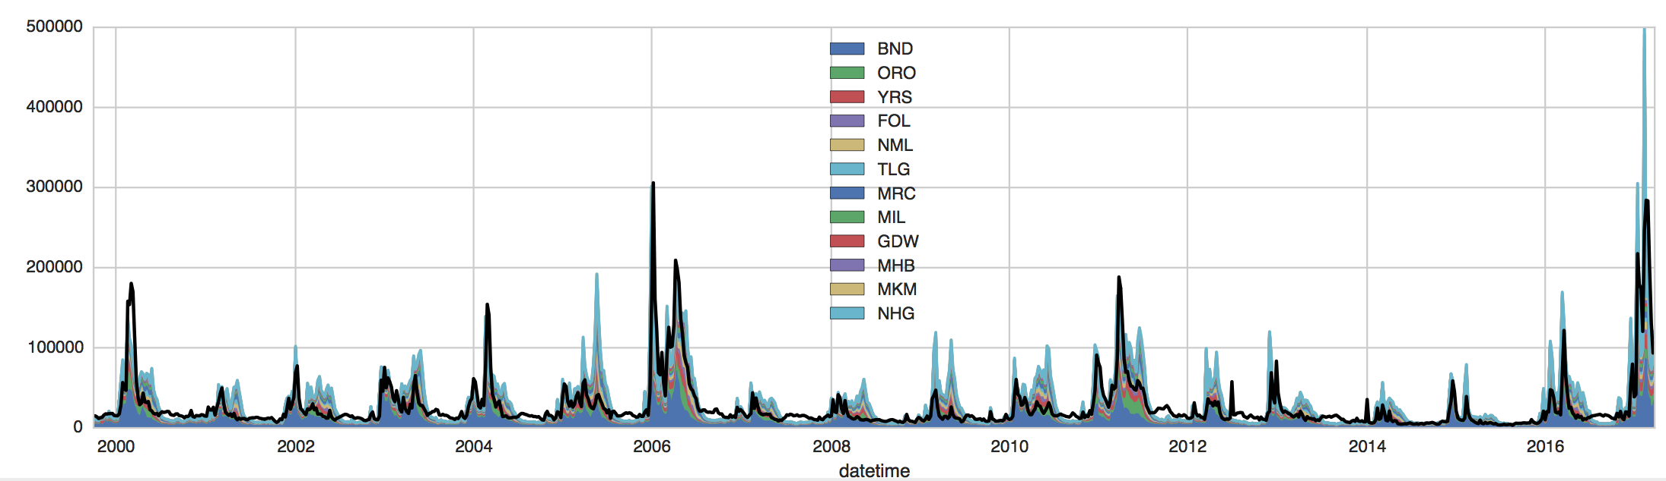
In winter months (flows too high to store), the sum of FNF lines up well with observed Delta inflow
(stations here: http://cdec.water.ca.gov/cgi-progs/staSearch?sta=&sensor_chk=on&sensor=8)

Slide 4
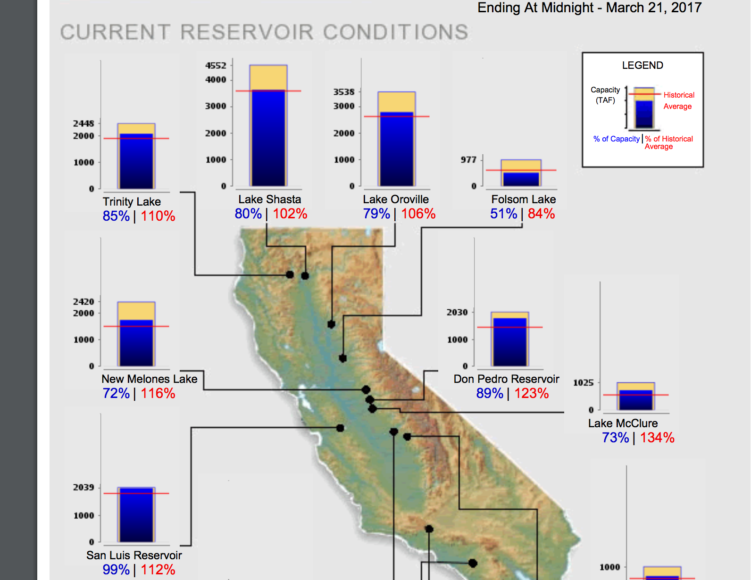
We’re focusing on Shasta, Oroville, Folsom reservoirs
Propose to use WRF streamflow from the other basins as “unimpaired flows” (additional gains into Delta)
Reason, we want to start from the inflows that Tamlin’s group develops without any other assumptions that only work in the historical scenario.
We can also use the FNF data to calculate water year type and 8RI

Slide 5
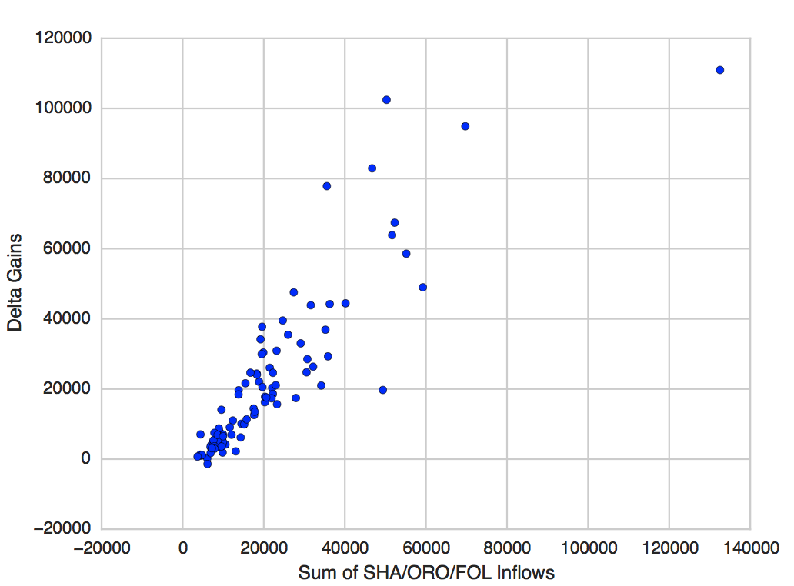
Or a simpler way using only the 3 inflows
All of the basins’ inflows are highly correlated, and so are their operations
Wet season (Nov-Jun) assume gains into the Delta are equal to 1.0 * the sum of SHA/ORO/FOL inflows

Slide 6
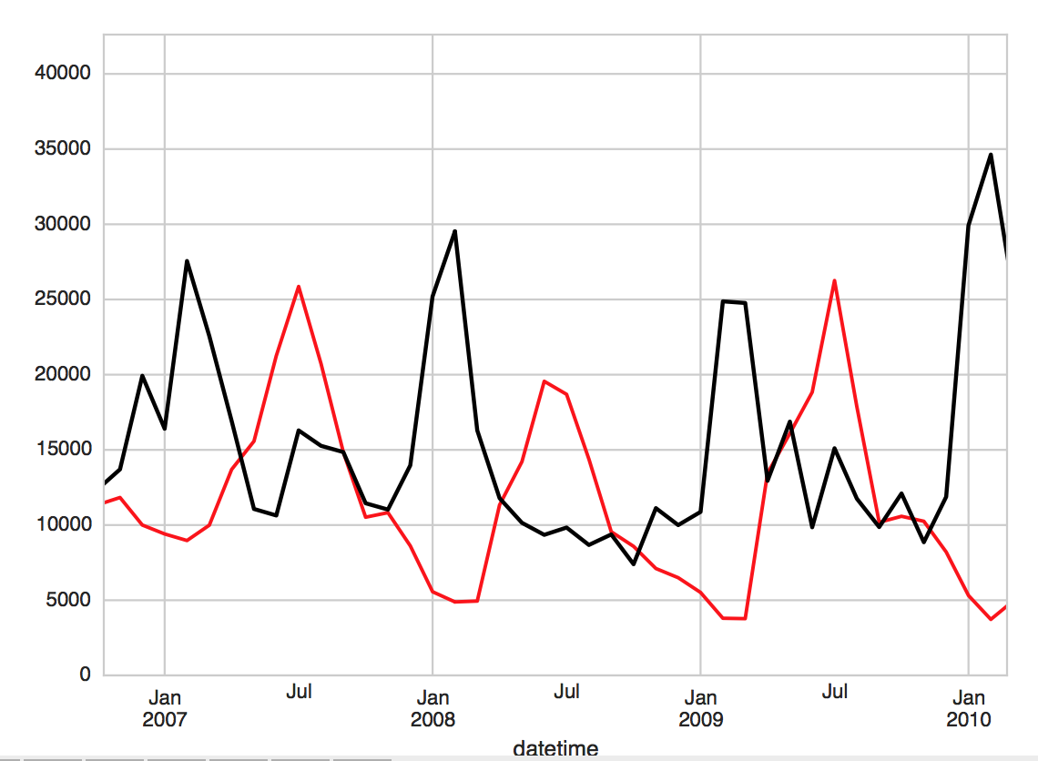
Diversions in summer
Some releases from SHA/ORO/FOL are consumed before reaching the Delta (Apr-Oct)
Assume these are fixed (estimated from CVP docs)

Slide 7
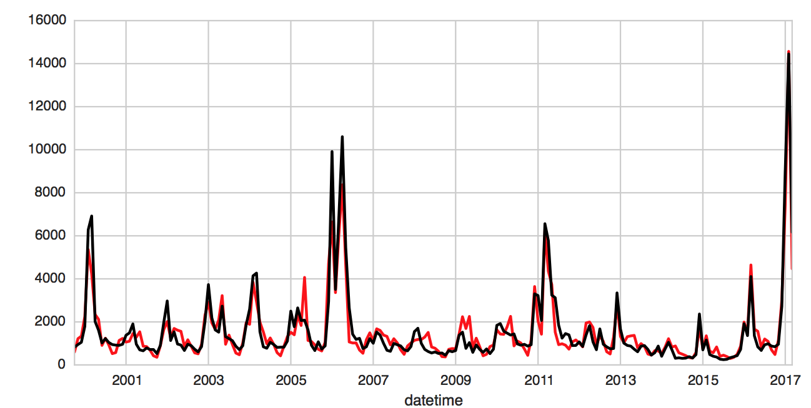
Does it work
Pretty well, with a few outliers. In terms of water supply it’s good enough. Monthly TAF.
(black = observed delta inflows; red = predicted)

Slide 8
Break down demand
CVP/SWP
North/South of Delta
Which reservoirs contribute how much
References:
https://www.usbr.gov/mp/cvp-water/docs/latest-water-contractors.pdf
http://www.water.ca.gov/swpao/swp-max-table-a.html
Note “contracted amounts” are rarely met in practice, even in wet years

Slide 9
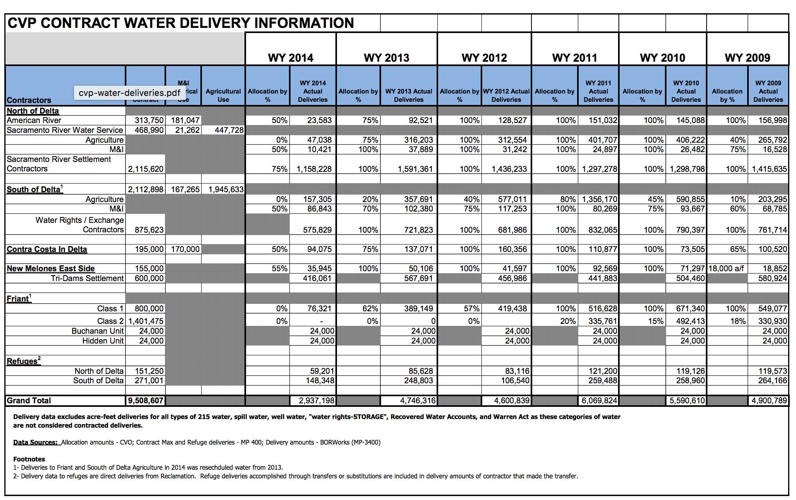
https://www.usbr.gov/mp/cvp-water/docs/cvp-water-deliveries.pdf

Slide 10
CVP assumptions / summary
~2 MAF/yr north of delta (these are senior water rights with highest priority, primarily ag)
~3 MAF/yr south of delta (also primarily ag) in the San Joaquin division
Ignore Friant division for now because their water is not pumped from the delta (check me on this, I think it’s from Millerton Reservoir))

Slide 11
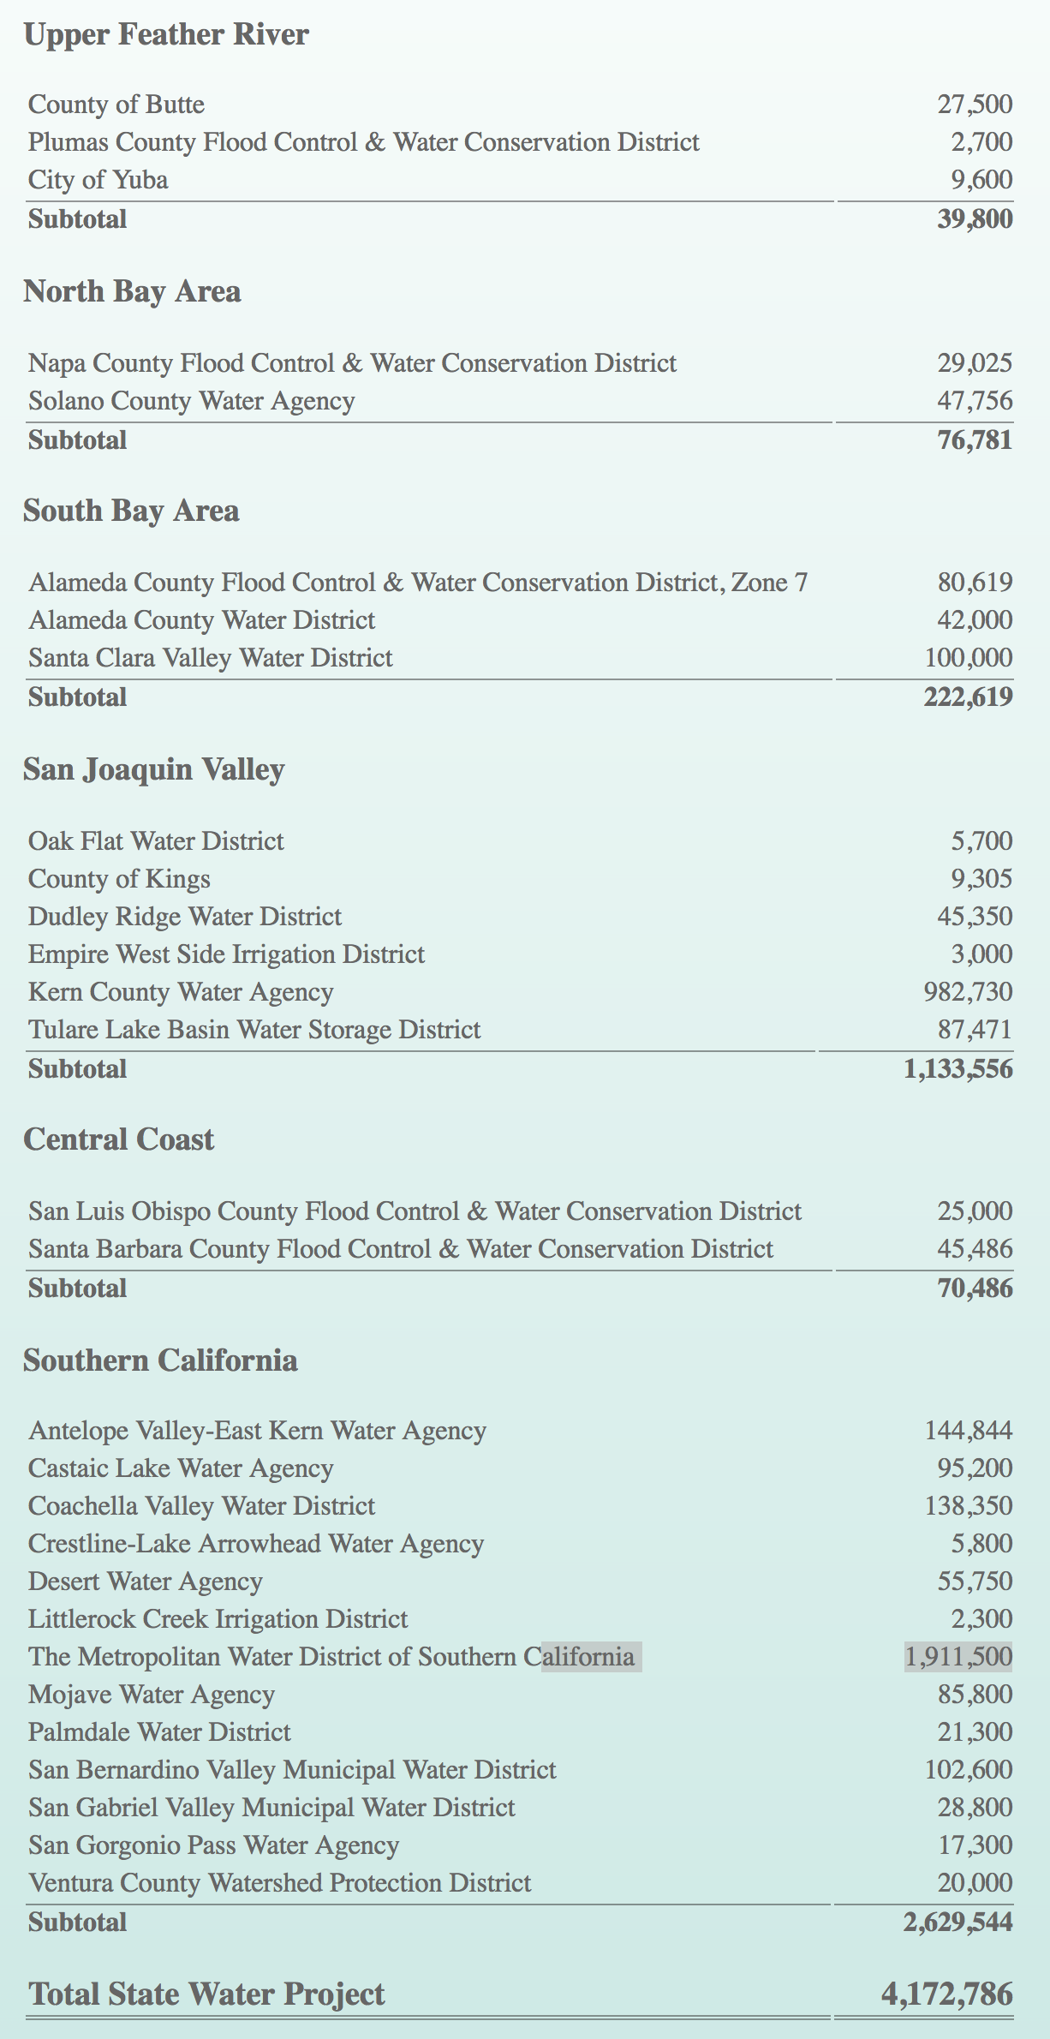
SWP
NOD consumptive demands are negligible
SOD ~ 3.6 MAF/yr (largest users KCWA and MWD)
During the drought, urban use had priority for “health and safety” reasons

Slide 12
Reservoir outflow components / assumptions
Local environmental requirements (=0 if satisfied by another flow)
Flood control release (use TOCS rule)
North of delta demand. Never curtailed. only applies to CVP (SHA/FOL), proportional to their storage volumes (SHA=82%, FOL=18%)
Delta outflow requirements. 75% CVP, 25% SWP (So, 61.5% SHA, 13.5% FOL, 25% ORO) (=0 if satisfied by flood control releases
South of Delta pumping (the mystery). Assume = pump capacity during wet years. Curtailed after that.

Slide 13
Demand timing
NODD is delivered right to agriculture, so it mostly shows up during the summer
SODD is pumped into San Luis Reservoir, so it can be pumped anytime during the year
In fact it’s better to do this during the winter when the environmental constraints aren’t as restrictive

